Slide 1
Adaptive Response to Local Environments in Ostrea lurida
Jake Heare

Slide 2
Committee Members
Steven Roberts (PI)
Kerry Naish
Bonnie Becker

Slide 3
Qualifying Experience
Bachelor of Science Marine Biology
Texas A&M University at Galveston
2009
Research Associate
Oyster Reproduction Lab
Louisiana State University
2011-2013
Master’s Student
Roberts Lab
School of Aquatic and Fisheries Science
University of Washington
2013-Present

Slide 4
Questions
1. Adaptive Advantage: Do native O. lurida populations have an advantage in survival and growth in their native environments compared to transplant populations?
2. Breeding Advantage: Do native O. lurida populations exhibit reproductive advantages in their native environments compared to transplant populations?
3.Balanced Polymorphism: Are O. lurida population genotypes selected for through environmental factors leading to a convergence of genotypes in each population?

Slide 5
Stages of Survival and Success
Broodstock Collection, Spawning, Outplantation
Adaptive Advantage
Breeding
Advantage
Balanced
Polymorphism
Important
Year 0
Important
Years 1-2
Important
Years 1-5
Important
Years 5 & Beyond
Determines Future Success
Determines
Outplant Survival Success
Determines
Recruitment
Success
Determines
Long term Population
Stability

Slide 6
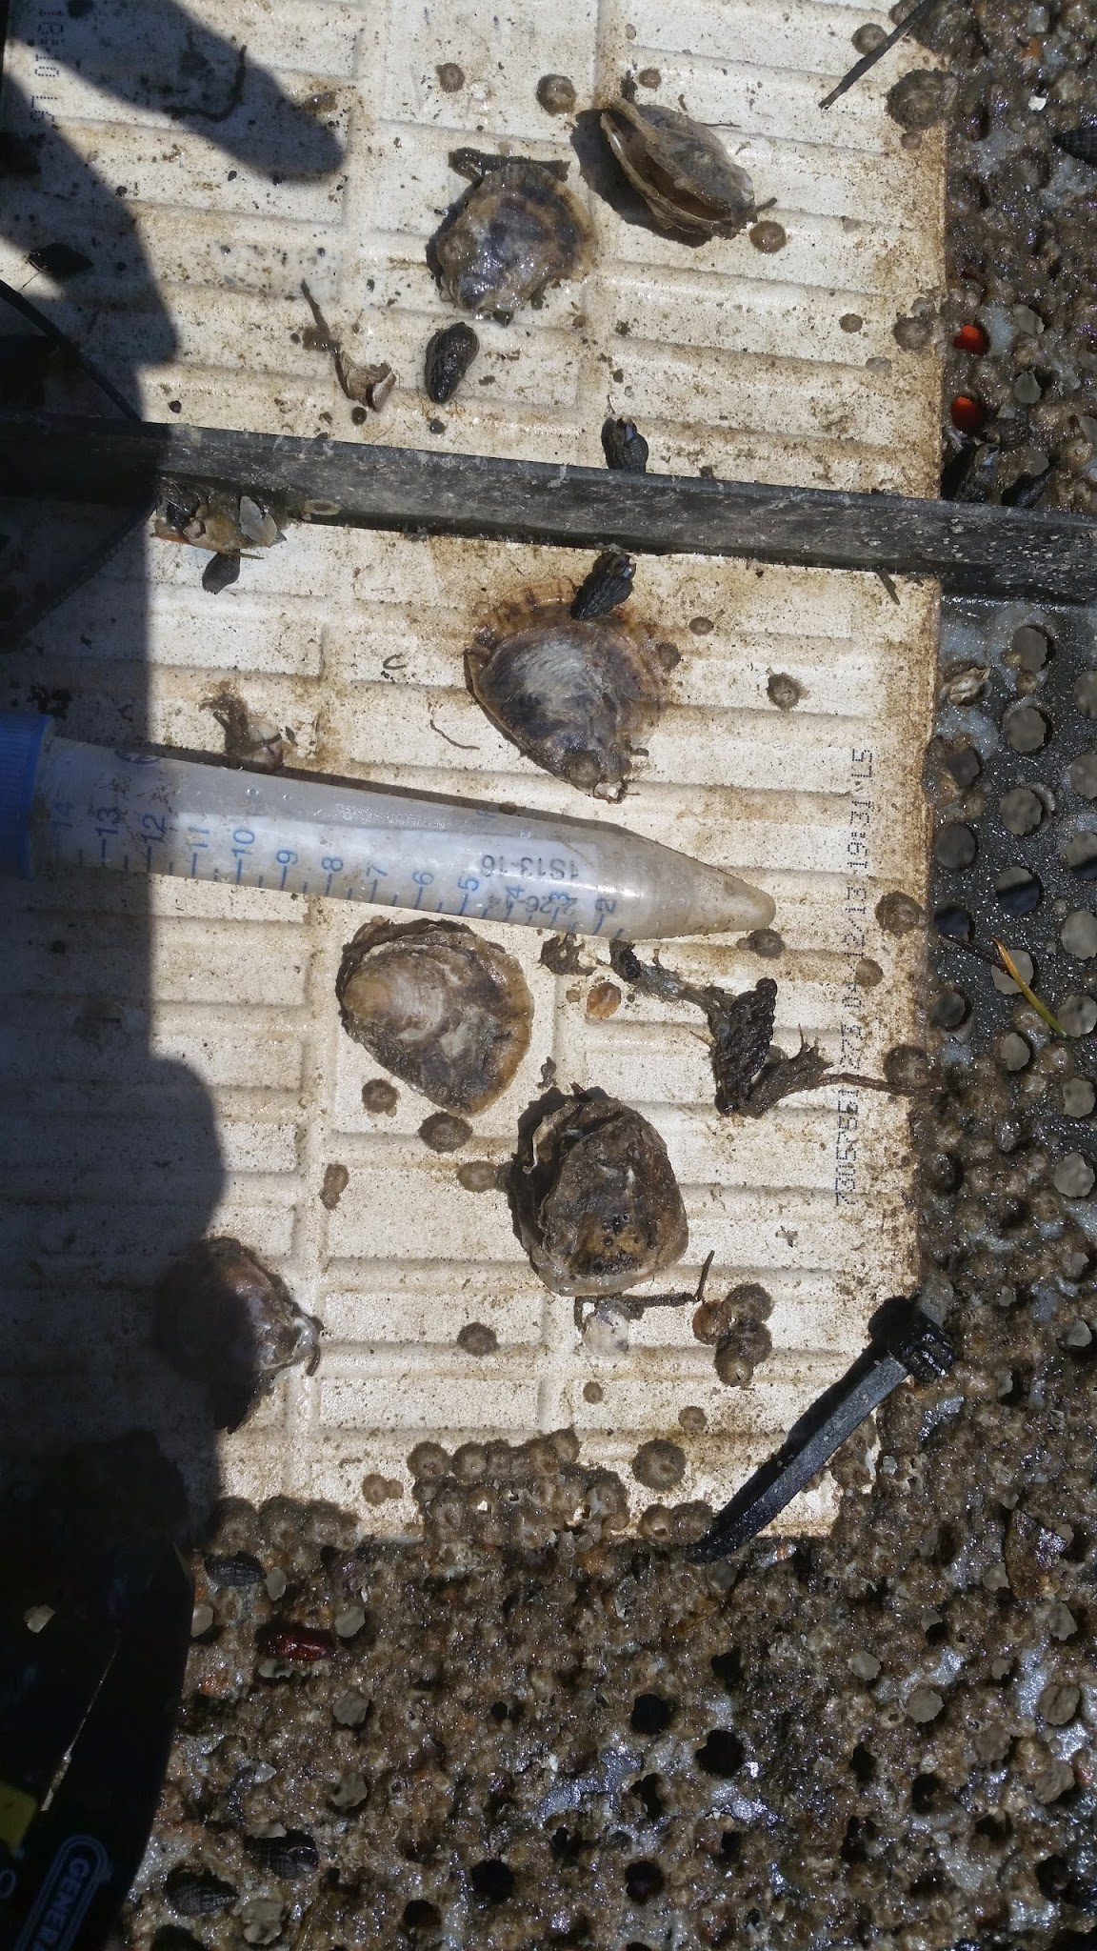
Adaptive Advantage
Compares Growth and Mortality
Within Sites
Between Sites
Between Populations
Within Populations

Slide 7
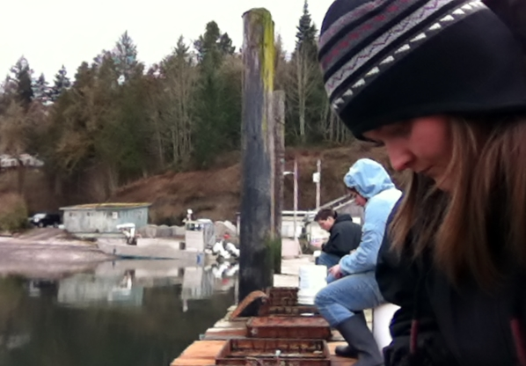
Adaptive Advantage (cont.)
To Do:
Monitor Growth and Mortality routinely for 2 years
Use statistical analysis to determine differences between populations
Produce reports for year 1 and year 2 data

Slide 8
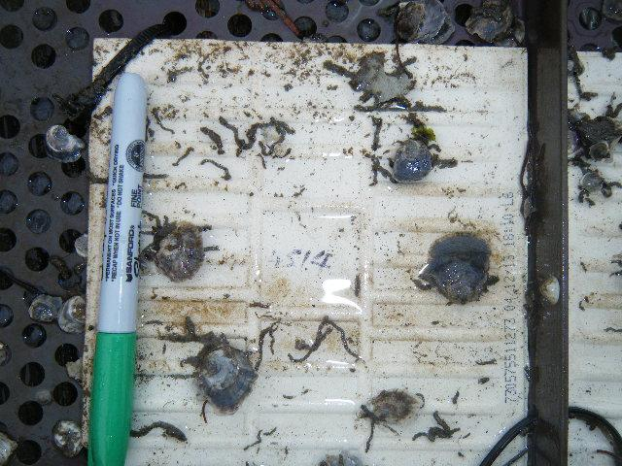
Adaptive Advantage (cont)
Have done:
Created F1 Offspring
Outplanted animals
Continually monitored for almost 1 year
Future efforts:
Run stats on year 1 data
Continue to Monitor throughout year 2
Run stats on year 2 data

Slide 9
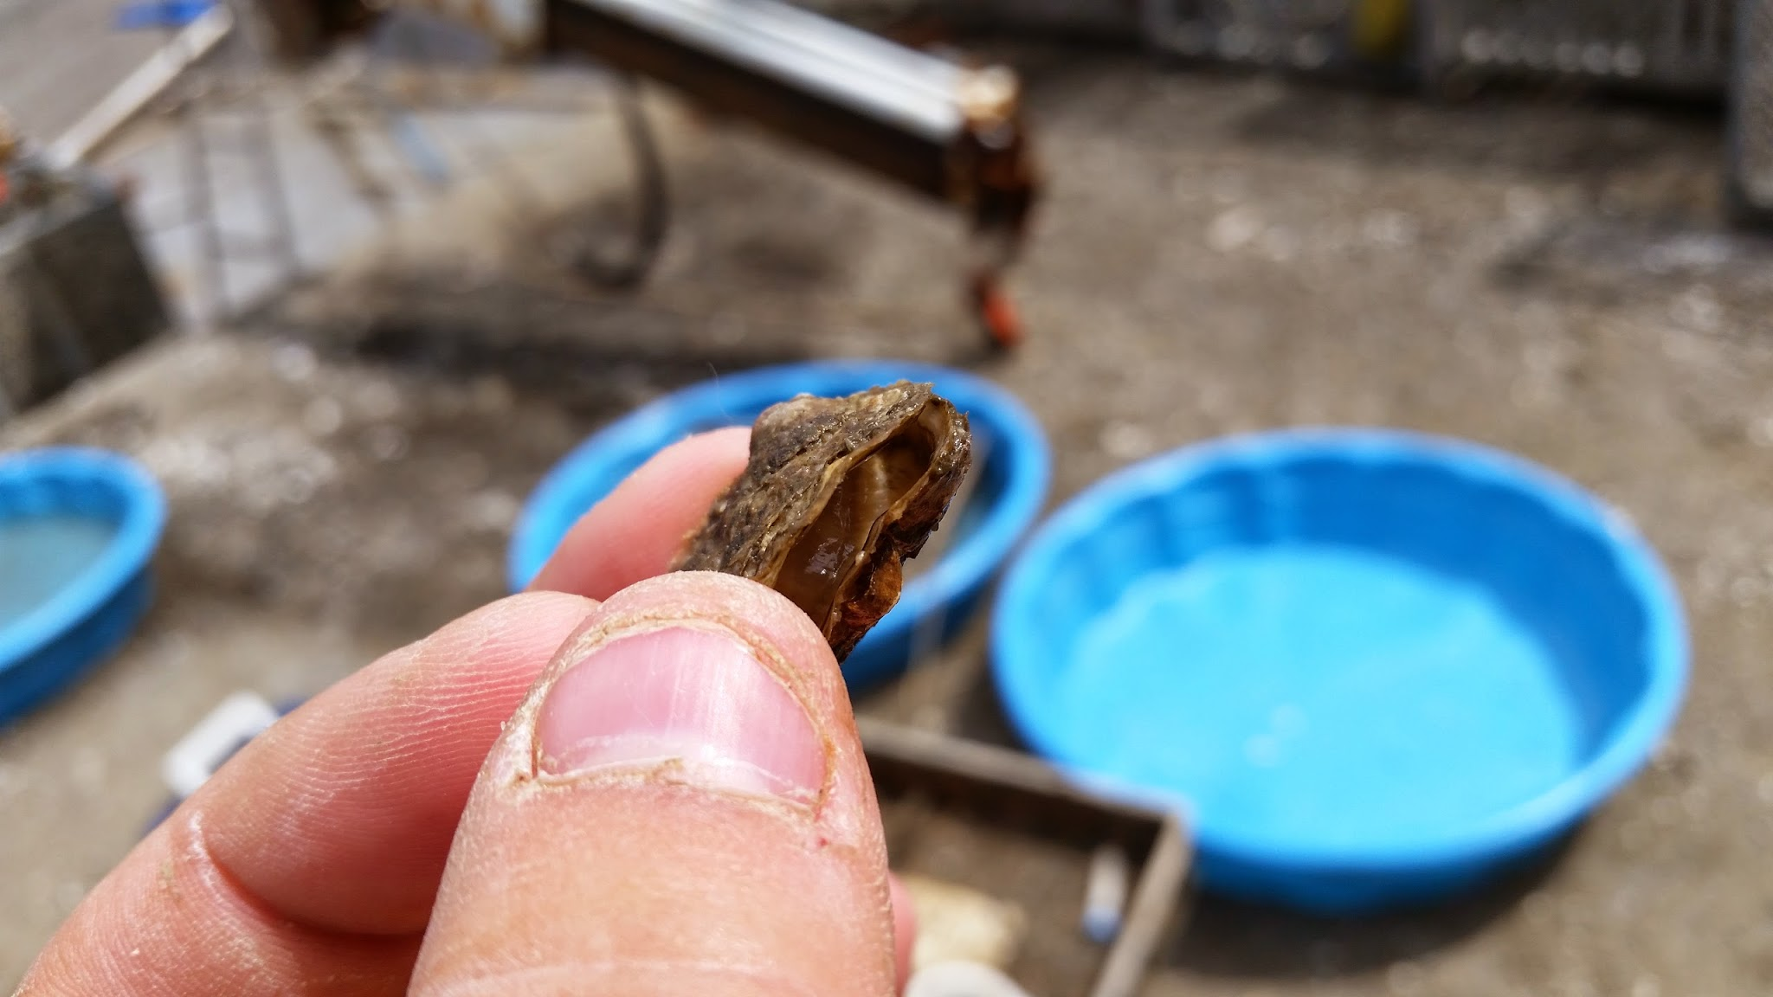
Breeding Advantage
Reproductive Success via
Brood Collection (Y1, Y2)
Histology (Y2)
Comparisons
Within/Between Sites
Between/Within Pops
Within/Between Years

Slide 10
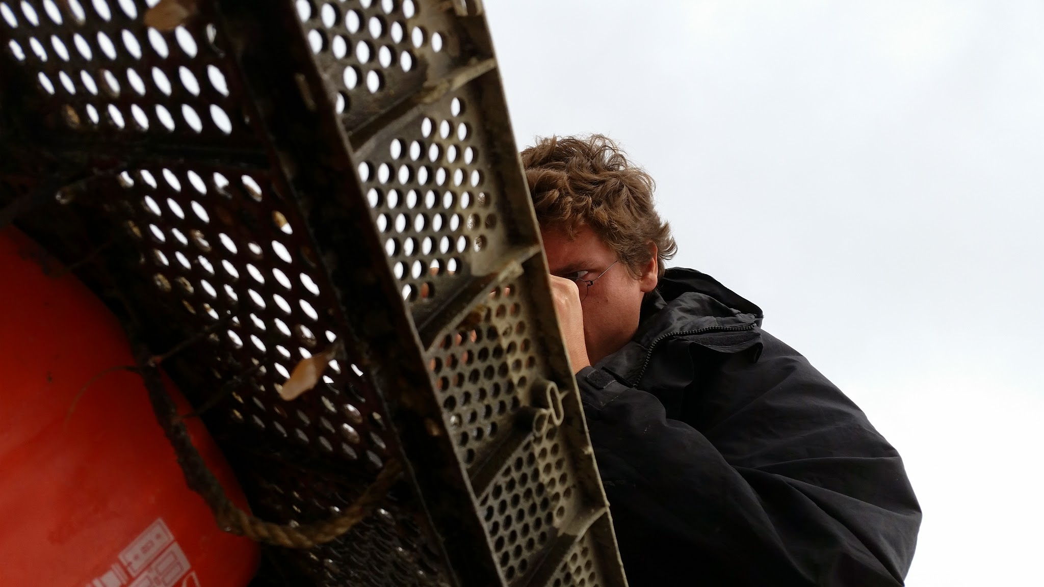
Breeding Advantage (cont.)
Have Done:
Collecting broods year 1
Measuring brooders
Future efforts:
Count broods
Year 2 brood collection
Histology
Stats

Slide 11
Balanced Polymorphism
Transplantation
Original Populations Polymorphism
Green Site dependent genotype
Red Site dependent genotype
Blue Site dependent genotype
Site Neutral genotype

Slide 12
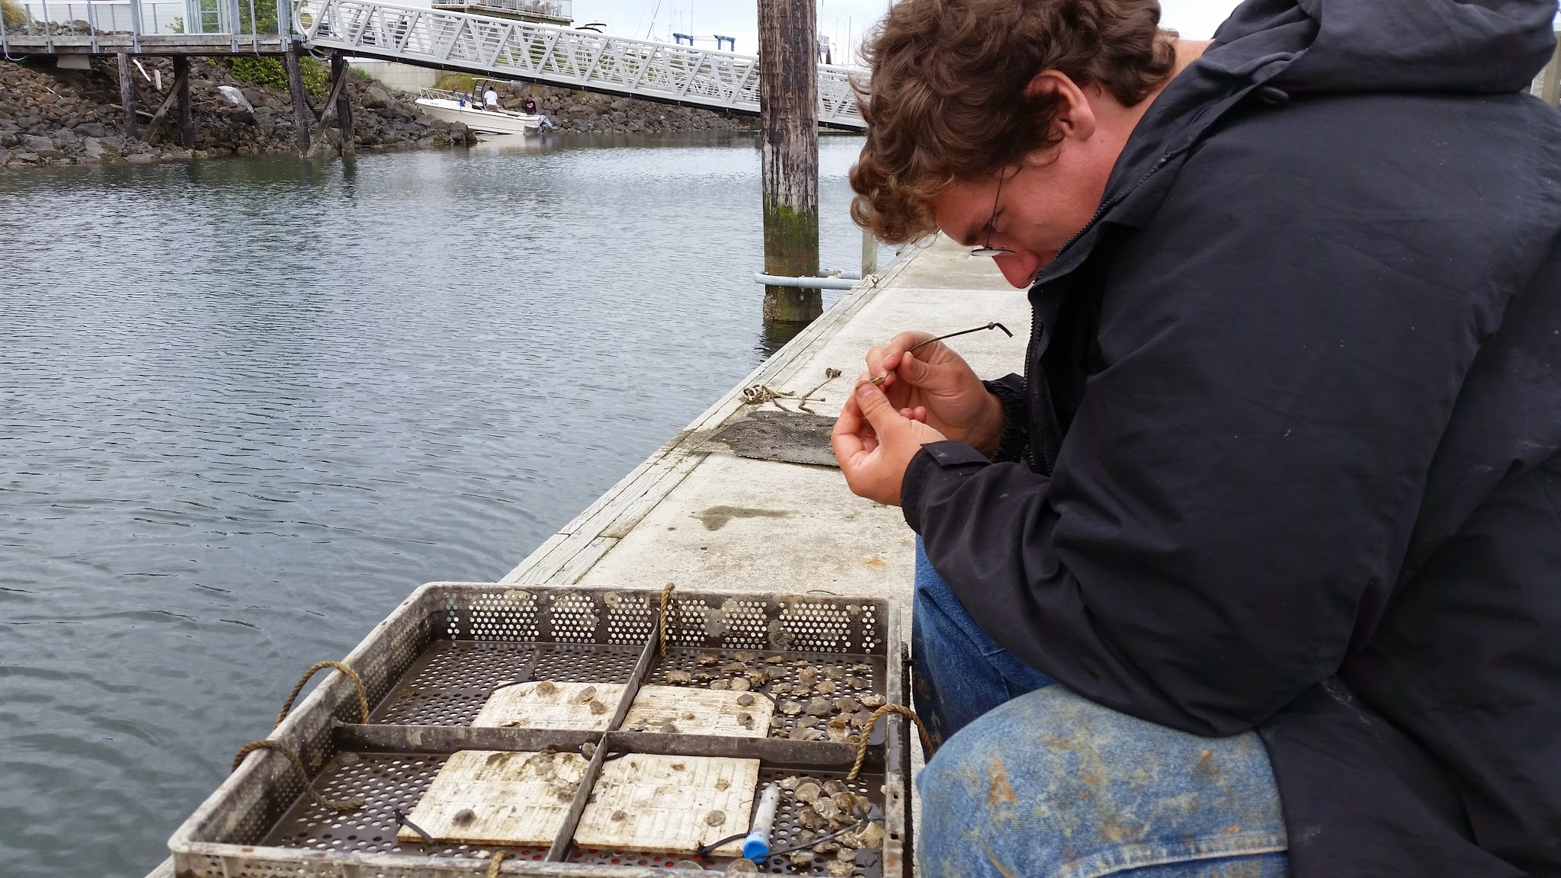
Balanced Polymorphism
Genotyping via
RAD-Seq
Cross Platform Bioinformatics Programs
Monitoring polymorphisms
Regular intervals
Major mortality events
Compare with pre outplanting
Compare with Growth/Mort/Reproductive Viability

Slide 13
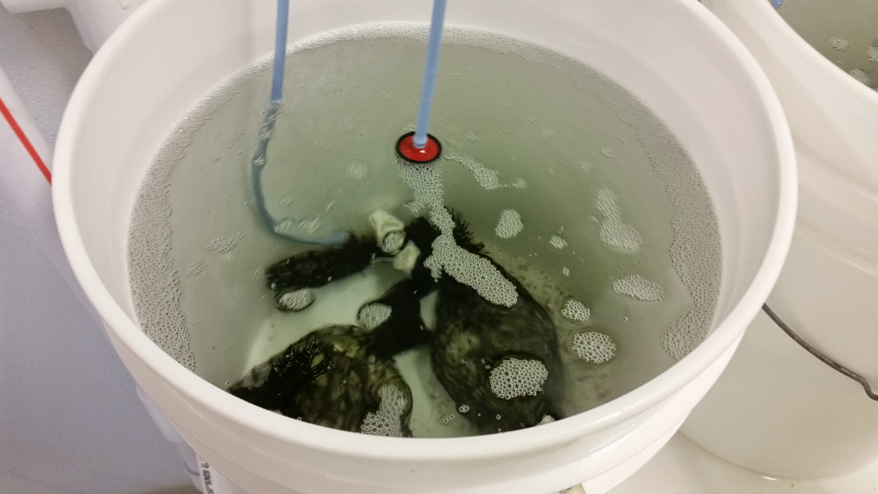
Balanced Polymorphism (cont.)
To Do:
Collect Samples
Pre outplant
post mortality events
regular intervals
Sequencing
Bioinformatics
Stats

Slide 14
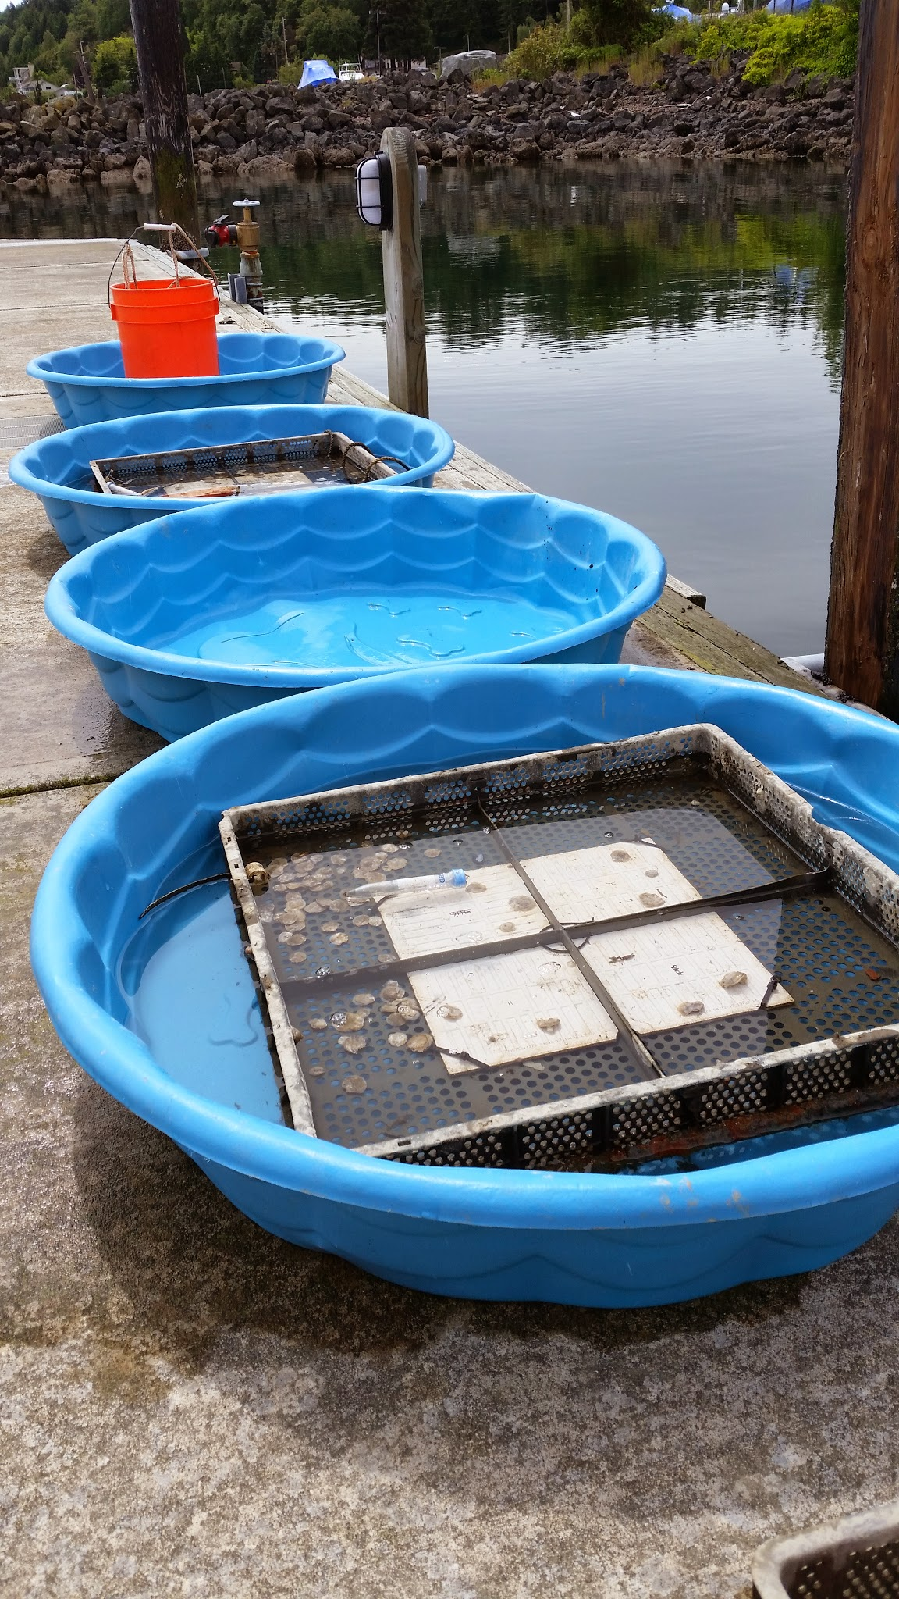
Balanced Polymorphism (cont.)
Have Done:
Collected pre-outplant, post-mortality event
Future Efforts
Continued sampling
Sequencing
Bioinformatics
Analysis

Slide 15
Timeline
 | 2014 | 2015
Activity | Spr | Sum | Fall | Win | Spr | Sum
Objective 1. Mort/Growth
Mort/Growth Metrics
Analysis
Report
Manuscript
Objective 2. Reproduction
Brood Collection
Count Larvae
Analysis
Manuscript
Chapter 3. Balanced Polymorphism
Collect Mortality Event Sample
DNA Isolation from Samples
Prep libraries for Sequencing
Rad Sequencing
Analysis
Write Manuscript
Progress toward degree
Committee meeting
Defense
Submit thesis to grad school

Slide 16
Coursework
Requirements:
QSCI 482, Statistical Inference in Applied Research, 5 credits.
FISH 510-514, Current Topics series, 2–5 credits
FISH 521*, Research Proposal Writing, 4 credits.
FISH 522*, Hot Topics in Aquatic & Fishery Sciences (offered credit/no credit only), 2 credits.
FISH 700, Thesis Research, 18 credits. (12 out of 18)
Earn 27 non-thesis course credits (i.e., not from FISH 700) (20 out of 27)
Earn 18 credits at the 500-level or higher (9 of which can come from FISH 700)
Earn 18 credits of numerically graded coursework with at least a 2.7 grade

Slide 17
Coursework Cont.
Summer 2014
FSH 700 (2 hrs)
Adds 2 hrs to 18 hrs FSH 700 bring it to 14 hrs
Fall 2014
FSH 511 (Evol/Ecol Issues) (2 hr)
FSH 552 (Intro R) (2 hr)
FSH 560 (Multivariate Stats) (4 hr)
FSH 700 (2 hrs)
Adds 8 hrs to complete 27 non thesis hours
Adds 1 510-515 course of 2 required
Adds 2 hrs to 18 hrs FSH 700 bringing total to 16 hrs
Winter 2015
FSH 521 Proposal Writing (4 hrs)
FSH 510-515 (2 hrs)
FSH 546 (3 hrs)
Completes Proposal writing requirement
Completes 510-515 requirement
Spring 2015
FSH 700
Completes 18 hrs FSH 700

Slide 19
Timeline Part 1
 | 2013 | 2014 |  |  |  | 2015
Activity | Fall | Win | Spr | Sum | Fall | Win
Objective 1. Mort/Growth
Out Planting
Mort/Growth Metrics
Year 1 Stats
Year 1 Report
Objective 2. Reproduction
Brood Collection Y1
Count Larvae
Year 1 Stats
Year 1 report
Chapter 3. Balanced Polymorphism
Collect Outplanting Sample
Collect Mortality Event Sample
DNA Isolation from Y1 Samples
Prep Y1 libraries for Sequencing
Rad Sequencing for Y1
analysis
Write Manuscript
Progress toward degree
Committee meeting
Defense
Submit thesis to grad school

Slide 20
Timeline Part 2
 | 2015 | 2016
Activity | Spr | Sum | Fall | Win | Spr | Sum
Objective 1. Mort/Growth
Mort/Growth Metrics
Year 2 Stats
Year 2 Report
Manuscript
Objective 2. Reproduction
Brood Collection Y2
Count Larvae
Histology
GtB Ratio
Year 1/2 Stats
Manuscript
Chapter 3. Balanced Polymorphism
Collect Mortality Event Sample
DNA Isolation from Samples
Prep Y1 libraries for Sequencing
Rad Sequencing for Y1
analysis
Write Manuscript
Progress toward degree
Committee meeting
Defense
Submit thesis to grad school

Slide 21
Coursework
Completed Coursework:
QSci 482 (5 hrs)
FSH 522 (2 hrs)
18 hours of FSH 700 (12 out of 18 hrs)
FSH 541 (5 hrs)
FSH 444 (5 hrs)
FSH 546 (3 hrs)

Slide 22
Coursework
Requirements:
QSCI 482, Statistical Inference in Applied Research, 5 credits.
FISH 510-514, Current Topics series, 2–5 credits (grading basis may vary depending upon the course/quarter offered); students are required to complete at least two of these courses during their graduate program. QERM 597 and FISH 578/BIOL 570A also count toward this requirement.
FISH 521*, Research Proposal Writing, 4 credits.
FISH 522*, Hot Topics in Aquatic & Fishery Sciences (offered credit/no credit only), 2 credits.
FISH 700, Thesis Research, 18 credits.
Earn 27 non-thesis course credits (i.e., not from FISH 700)
Earn 18 credits at the 500-level or higher (9 of which can come from FISH 700)
Earn 18 credits of numerically graded coursework with at least a 2.7 grade
Earn at least 18 credits of FISH 700

Slide 23
Balanced Polymorphism
Transplantation
Original Populations Polymorphism
Green Site dependent genotype
Red Site dependent genotype
Blue Site dependent genotype
Site independent genotype

